Slide 1
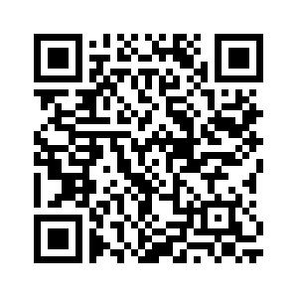
NO MORE DUBIOUS VIDEOGAME OWNERSHIP RIGHTS
Let's save what we rightfully own from the void!
People within the EU, sign the petition!
1. What is this petition about?
4. When is the deadline to sign?
This petition (officially called 'Stop Destroying Videogames') advocates for games that shut down, are abandoned, or no longer supported to be left in a playable state for consumers. By the publishers of said games.
The deadline is the 31st of July 2025. Share this image or the petition link with your family, friends, and on social media!
Give it
5. If this is implemented, won't a bunch of publishers leave the EU market?
2. Is this legit?
Yes — this is an official EU petition, hosted on the European Union’s own platform (URLs ending in europa.eu). It’s not just a random online petition. This initiative is backed by real organizers from seven EU countries and has been formally approved.
Yes, some may. However, the effect of the changes will not be immediate. The organisers and the EU will surely give ample time for publishers to implement the changes necessary to comply with the new rules. Remember, the rules are for the *end* of a game's life, not its beginning or present state.
3. How do I sign?
a chance!
Scan the QR code on this image or search 'Stop Destroying Videogames' on the European Citizens' Initiative website. Click on the yellow button where it says 'Support this initiative' and then choose your EU country of residence, then go through the verification process. Only people within the EU can sign this petition.
6. I'm not from the EU, why should I care?
While these proposed changes do not affect you directly, it's not impossible that it may later down the line. Just like the enforcement of USB-C type charging ports for iPhones in the EU and subsequently the rest of the world, this too can have a snowball effect. This change can benefit you too! So please, spread the word.

